Slide 1


DEPARTMENT OF COMPUTER SCIENCE AND ENGINEERING
20CS8504 & PROJECT WORK
END SEMESTER PRACTICAL EXAMINATION- APRIL / MAY - 2026
Batch No.: 10
Date: 30.03.2026
Session:AN

Slide 2
INTELLIGENT CROP RECOMMENDATION SYSTEM BASED ON SOIL PARAMETERS AND IMAGE ANALYSIS
Guide Name:
RAJENDRA KANNAMMAL.G M.E.,
Team Members:
MAYURI DEVI S (811722104088)
MONIKA M (811722104092)
NANDHINI K (811722104098)
PRIYADHARSHINI A (811722104114)

Slide 3
OBJECTIVE OF THE PROJECT
To develop a machine learning system that analyzes soil parameters such as nitrogen, phosphorus, potassium, pH, temperature, humidity, and rainfall to recommend suitable crops.
To identify soil characteristics using deep learning by analyzing soil images and providing accurate crop and fertilizer recommendations.
To help farmers make better agricultural decisions by suggesting the most suitable crop seed and fertilizer based on soil conditions.

Slide 4
INTRODUCTION
Agriculture is an important sector for food production and the economy.
Choosing the right crop and fertilizer depends on soil condition.
Farmers sometimes do not have enough information about soil nutrients.
Machine learning can analyze soil data and soil images to suggest suitable crops.
This project recommends the best crop seed and fertilizer based on soil details.

Slide 5
LITERATURE SURVEY
TITLE OF PAPER | AUTHOR(S) | PAPER GIST | TECHNOLOGY USED
Deep Learning-Based Crop Recommendation Using Soil and Environmental Parameters | FO Ozkok | EPSTEM Journal | CNN, Image Processing
Crop Suitability Prediction Using Soil Texture Images | K. Karthik | RJWave Publications | CNN, Transfer Learning
Machine Learning Based Crop Recommendation System | FS Prity | Springer | Random Forest, Ensemble ML
Agricultural Crop Recommendation Using ML Techniques | Multiple Authors | Elsevier | XGBoost, SVM

Slide 6
LITERATURE SURVEY
TITLE OF PAPER | AUTHOR(S) | PAPER GIST | TECHNOLOGY USED
Crop Recommendation Based on Soil and Climate Parameters | P. Ayesha Barvin | MDPI | Random Forest, KNN
Intelligent Crop Prediction System Using ML | S. Patel | IRJET | Naive Bayes, ML
Machine Learning Approaches for Precision Agriculture | J. Lee | ACM | ML Algorithms, Data Analytics
Smart Agriculture Using AI and Image Processing | A. Sharma | IEEE | CNN, OpenCV

Slide 7
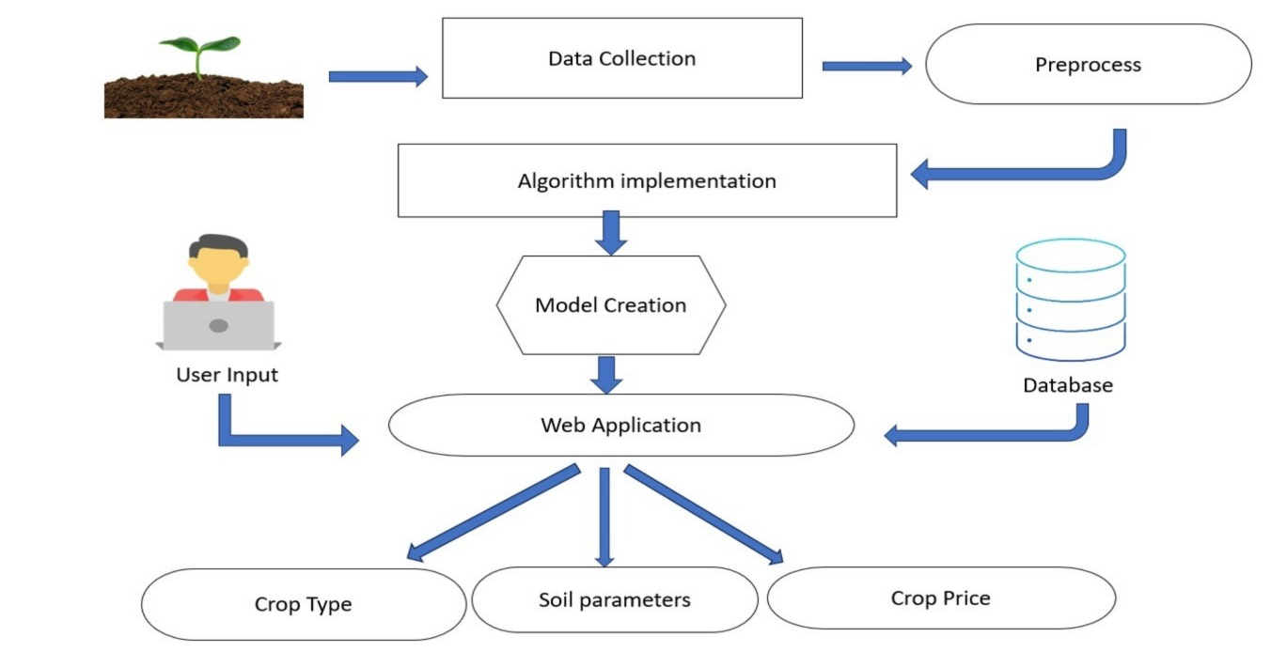
EXISTING SYSTEM ARCHITECTURE

Slide 8
PROBLEM IDENTIFIED
Farmers have lack of knowledge about soil nutrients and suitable crops.
Soil testing facilities are not easily available in rural areas.
Farmers mostly depend on traditional farming methods and guesswork
Existing systems do not provide accurate crop recommendations based on
soil data.
Improper crop selection leads to low crop yield and financial loss.

Slide 9
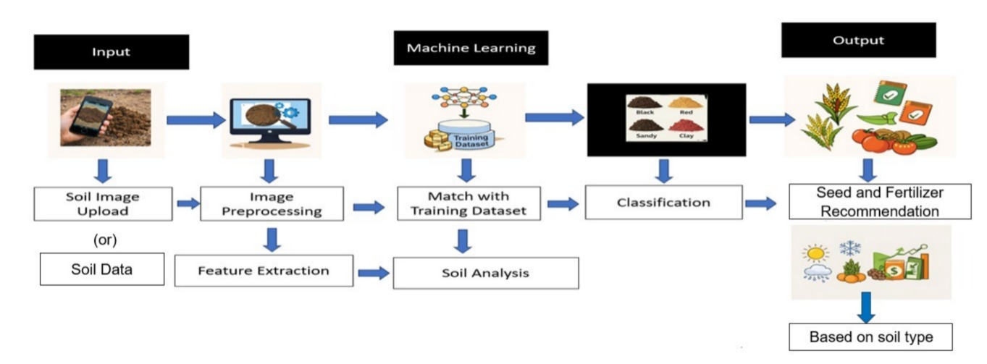
PROPOSED SYSTEM ARCHITECTURE

Slide 10
SOFTWARE AND HARDWARE REQUIREMENTS
HARDWARE
1. Laptop / PC
2. Processor: i3 or above
3. RAM: 4 GB minimum
4. Hard Disk: 256 GB
5. Camera / Mobile
SOFTWARE
1. Operating System: Windows
2. Programming Language: Python 3.7.5
3. Frontend: HTML, CSS, JavaScript
4. Backend Tool: PyCharm
5. Database: MySQL

Slide 11
MODULES
Farmer Interaction Module
Soil Information Analysis Module
Dataset Training Module
Crop Prediction Module
Crop and Fertilizer recommendation Module

Slide 12
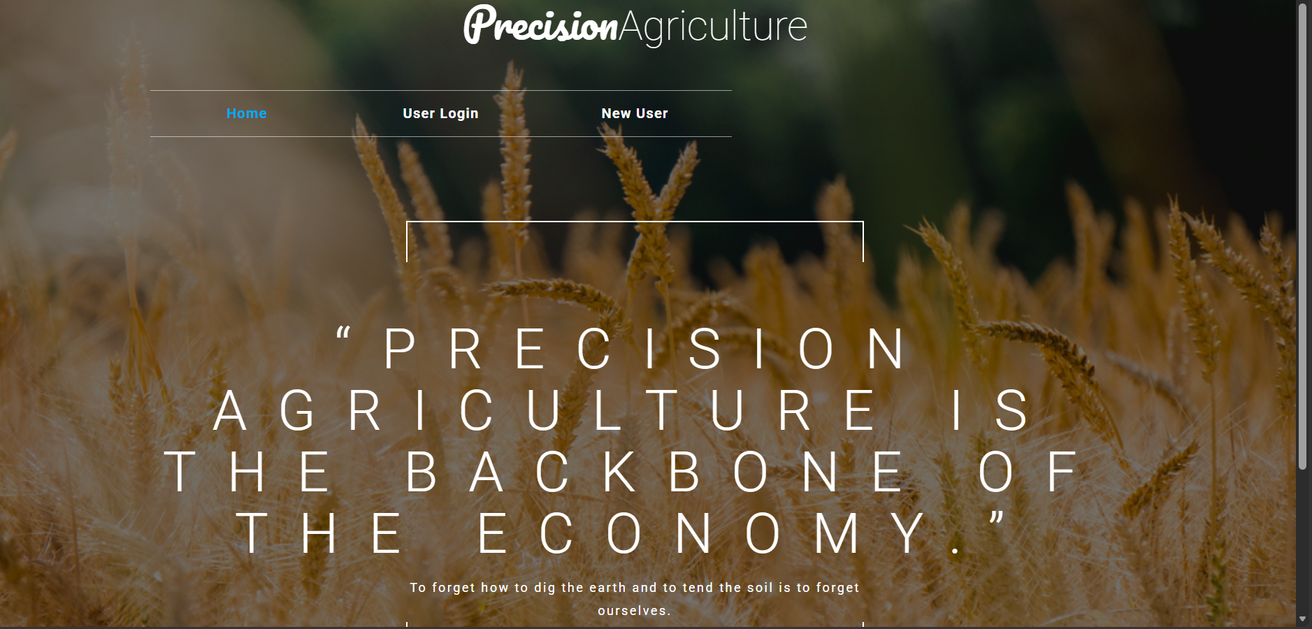
FARMER INTERACTION MODULE
This module allows farmers to interact with the system.
Farmers can enter soil details like nitrogen, phosphorus, potassium, pH, temperature, humidity, and rainfall.
Farmers can upload soil images.
The system collects the information from the farmer.
The data is sent to the system for analysis.

Slide 13
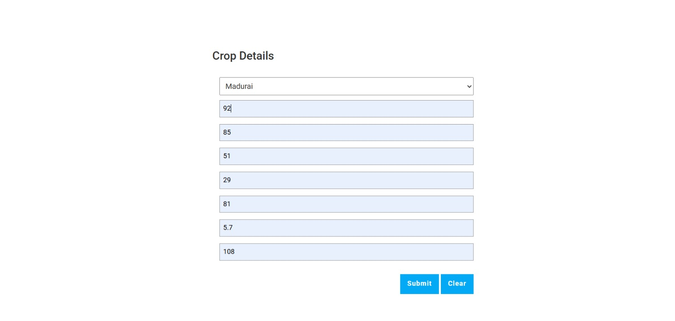
SOIL INFORMATION ANALYSIS MODULE
This module analyzes the soil data entered by the
user.
It checks whether the data is correct.
The system processes soil nutrients and environmental factors.
The soil condition is identified.
The analyzed data is sent to the prediction module.

Slide 14
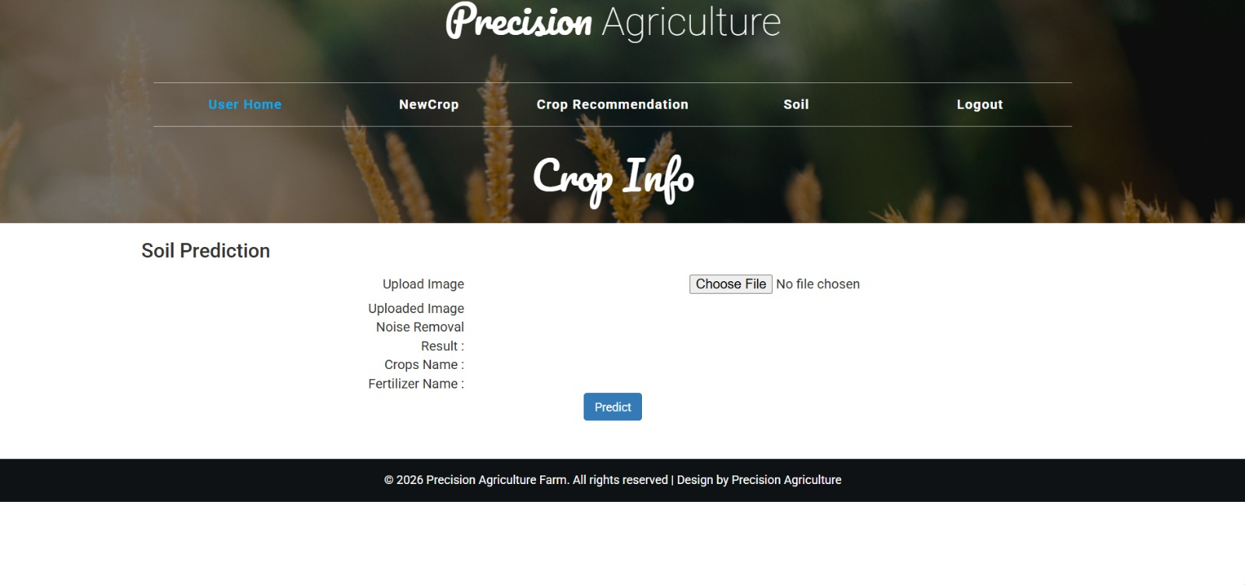
DATASET TRAINING MODULE
This module uses dataset collected from Kaggle.
The dataset contains soil parameters and crop information.
Machine learning models are trained using this dataset.
The system learns patterns from the data.The trained model is used for prediction.

Slide 15
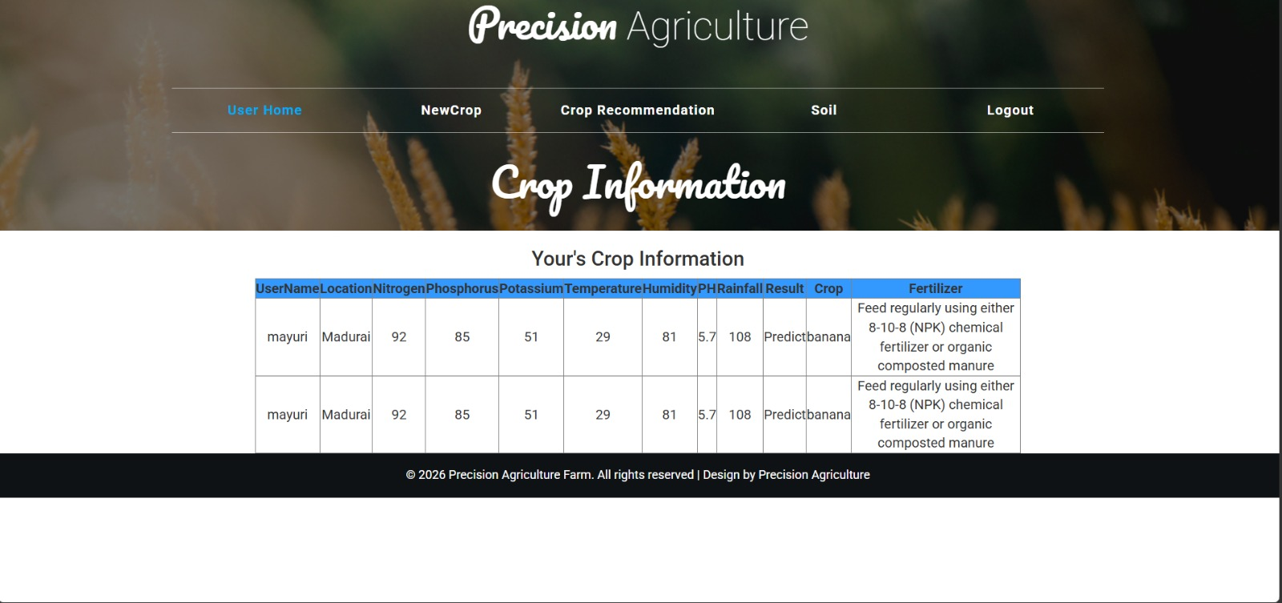
CROP PREDICTION MODULE
This module predicts the suitable crop based on soil data.
It uses machine learning algorithms for prediction.
The system analyzes soil parameters like nitrogen, phosphorus, potassium, pH, temperature, humidity, and rainfall.
The input data is compared with the trained dataset.
The system predicts and displays the best crop for the given soil condition.

Slide 16
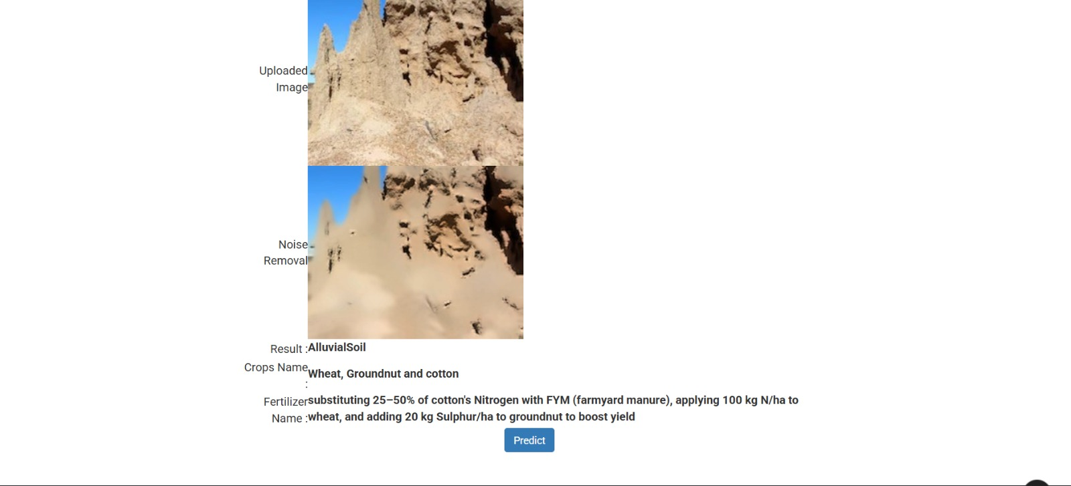
CROP AND FERTILIZER RECOMMENDATION MODULE
This module recommends suitable fertilizers based on soil nutrient levels.
It checks the nutrient requirements of the predicted crop.
The system suggests fertilizers that improve soil fertility.
Proper fertilizer usage helps increase crop yield and productivity.
The final crop and fertilizer recommendation is displayed to the farmer.

Slide 17
CONCLUSION
The system analyzes soil data and soil images using machine learning and deep learning techniques.It helps identify suitable crops based on soil nutrients and environmental conditions.
The system also recommends the appropriate fertilizer for better crop growth.This technology helps farmers make better farming decisions.

Slide 18
FUTURE ENHANCEMENTS
The system can include real-time weather data for more accurate crop recommendations.A mobile application can be developed so farmers can easily use the system on smartphones.
More advanced machine learning models can be added to improve prediction accuracy.The system can support multiple languages to help farmers from different regions.

